Slide 1
Customizable Displays with Smart LEDs
Barbara Ameloot & Wouter Jochems
Begeleid door prof. dr. Danny Hughes
Met ondersteuning van Marnick Vandecauter & Bart Veys

Slide 2
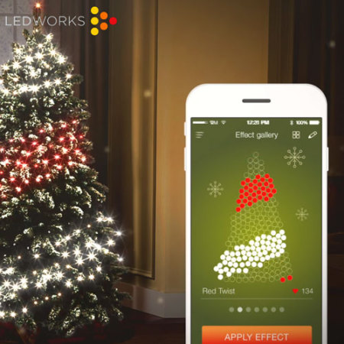
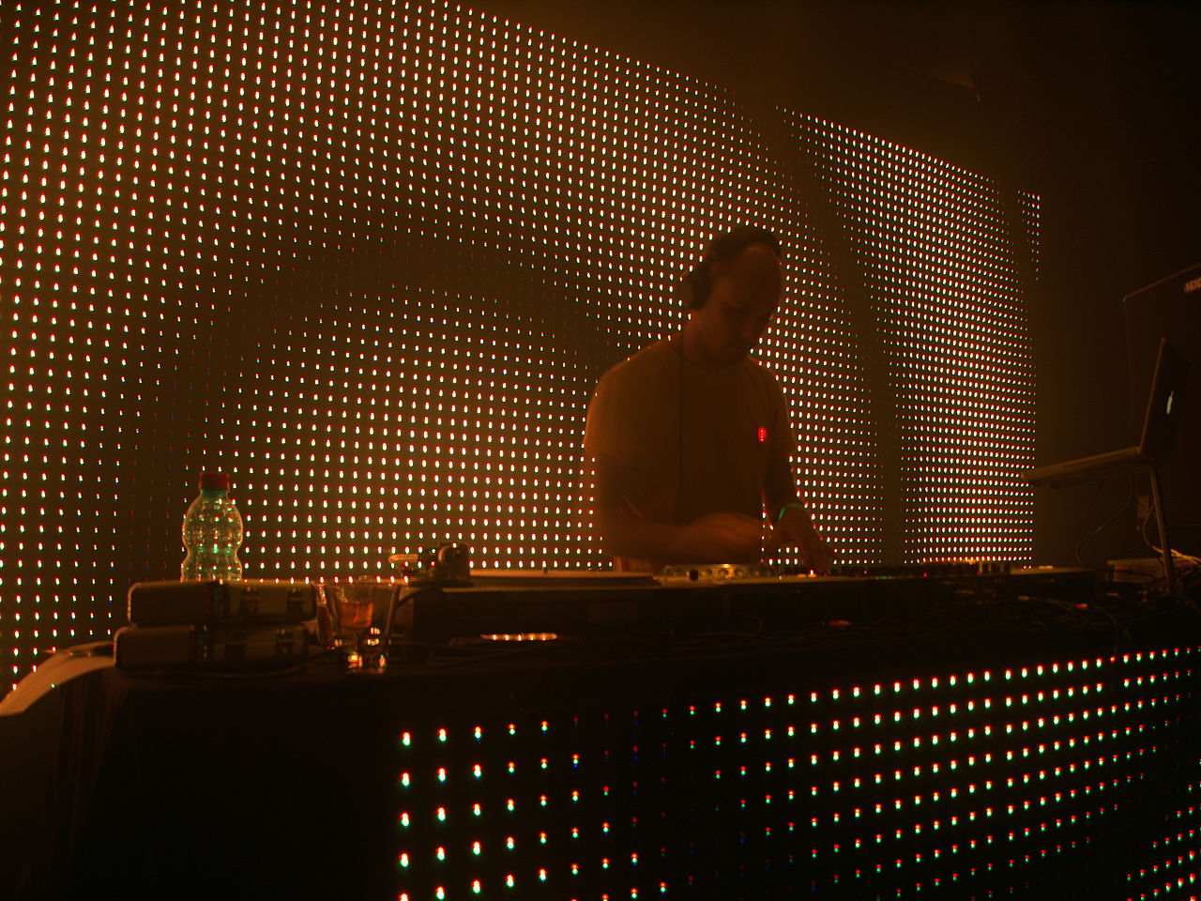
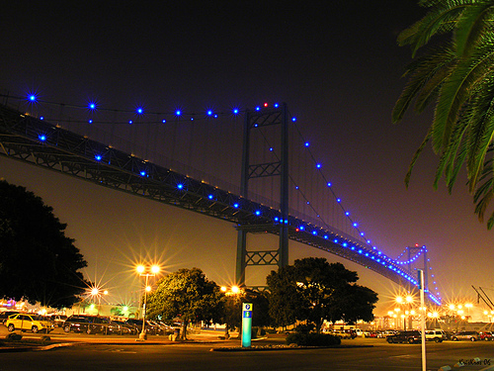
Smart LED
Inleiding | VLC | Lichtmeting | LED to LED | Idee | Kleuren | Protocol | Samenvatting

Slide 3
Smart LED Wat is het?
"A complete computer equipped with basic optical networking that fits within the size constraints of a standard 10mm LED."
Micro Controller
Inleiding | VLC | Lichtmeting | LED to LED | Idee | Kleuren | Protocol | Samenvatting

Slide 4
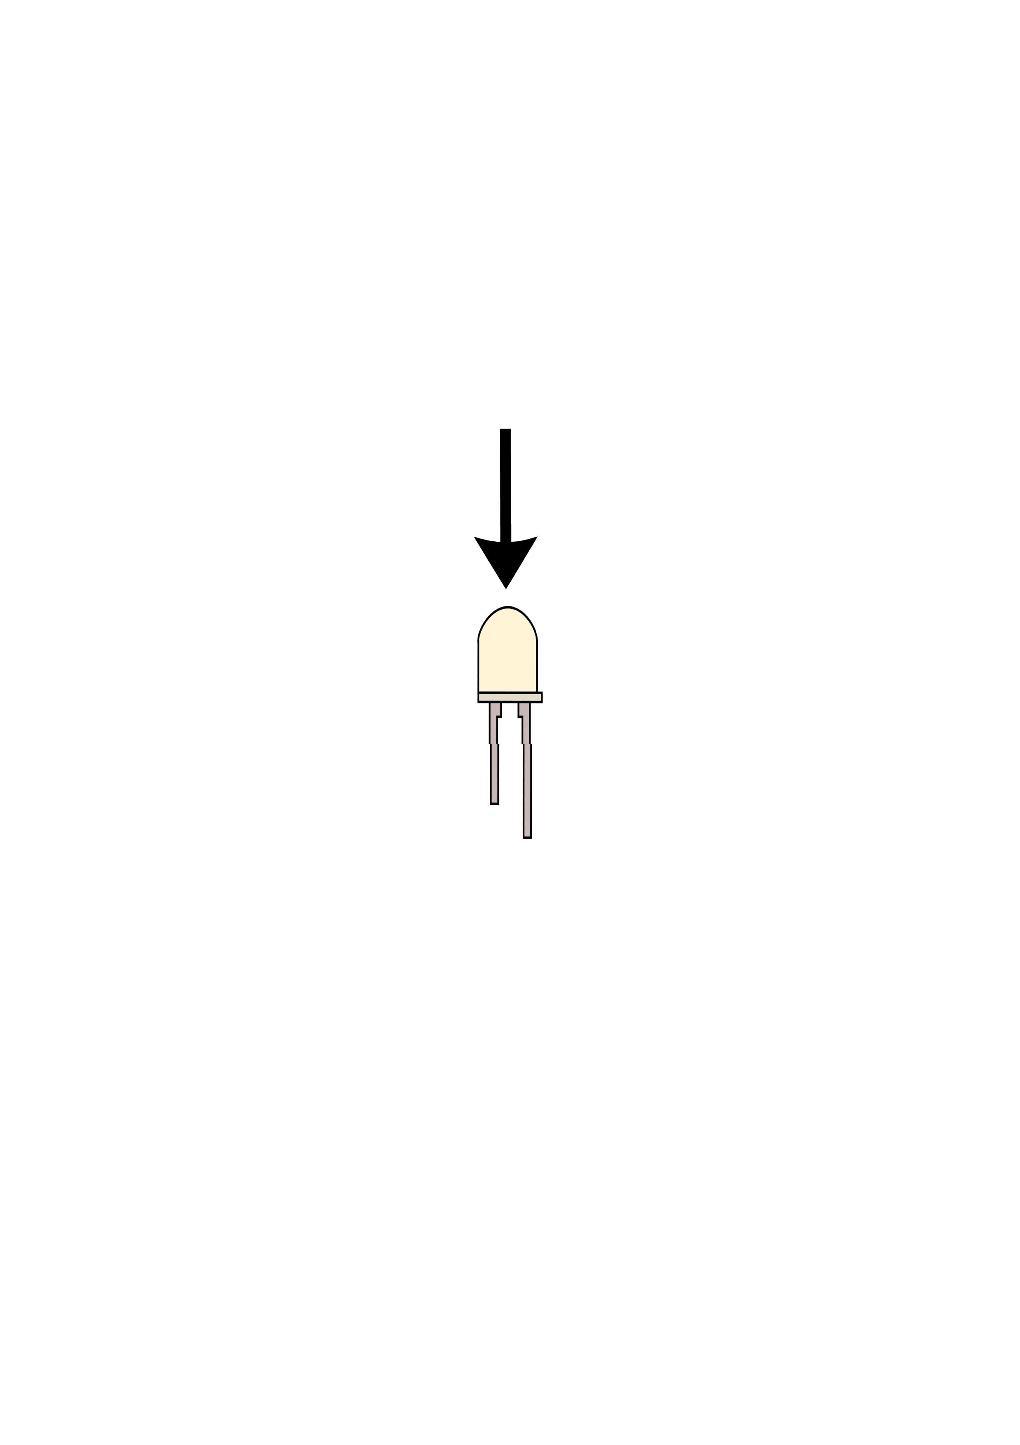
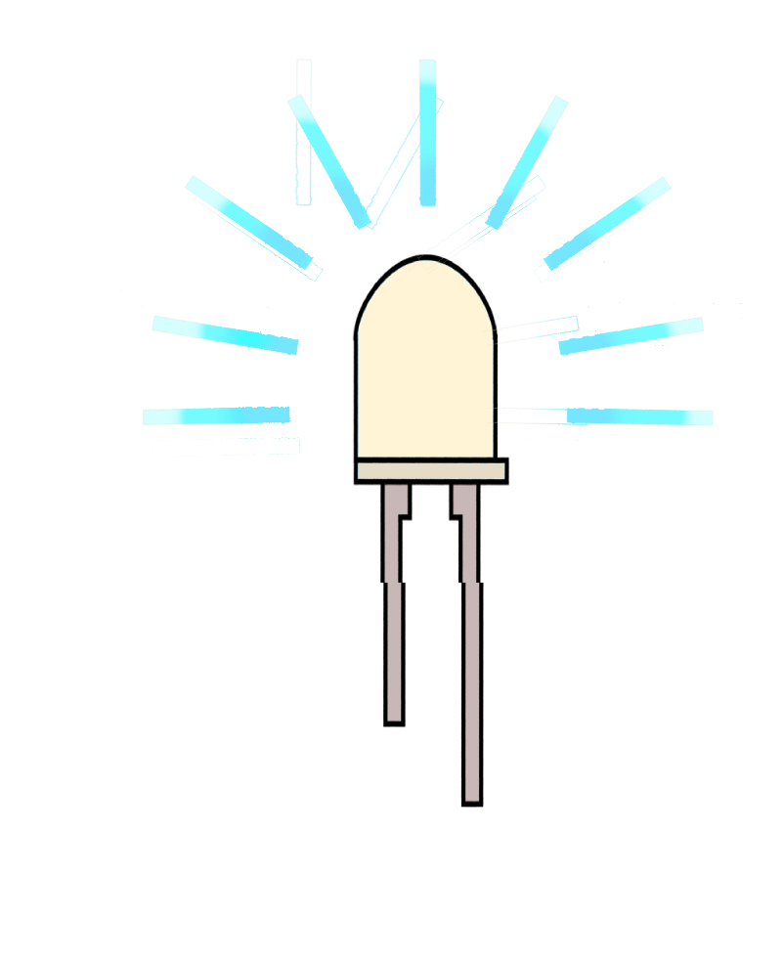
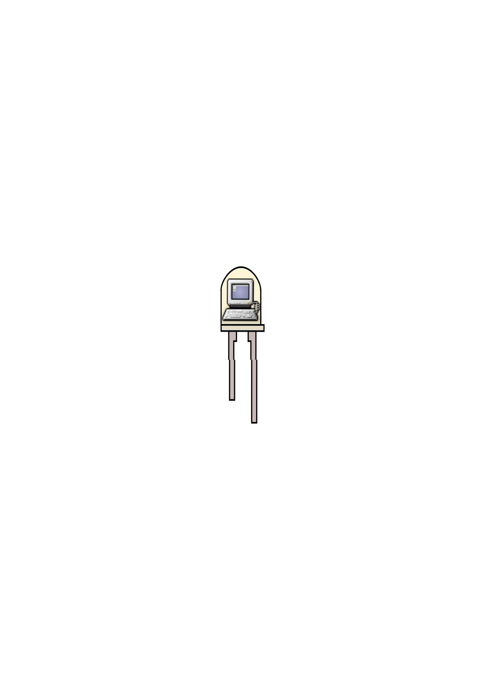
Smart LED
Wat kan het?
Licht zenden
Licht opvangen
Programmerbaar
Inleiding | VLC | Lichtmeting | LED to LED | Idee | Kleuren | Protocol | Samenvatting
Inleiding | VLC | Lichtmeting | LED to LED | Idee | Kleuren | Protocol | Samenvatting

Slide 5
Smart LED Wat kunnen we ermee doen?
Inleiding | VLC | Lichtmeting | LED to LED | Idee | Kleuren | Protocol | Samenvatting
Inleiding | VLC | Lichtmeting | LED to LED | Idee | Kleuren | Protocol | Samenvatting

Slide 6
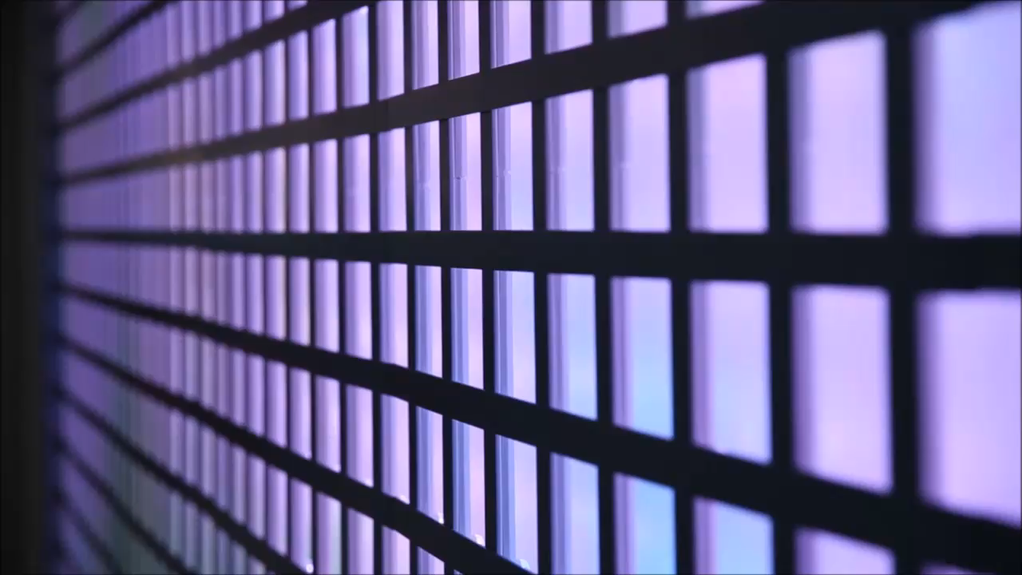

Slide 7
Smart LED
VLC
Lichtmeting
LED to LED
Idee
Kleuren
Protocol
Samenvatting
Inleiding | VLC | Lichtmeting | LED to LED | Idee | Kleuren | Protocol | Samenvatting

Slide 8
VLC
Visual Light Communication

Slide 9
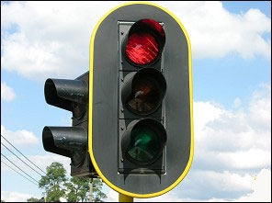
Bron: https://www.gratisrijbewijsonline.be/theorie/leerstof-rijbewijs-b/voorrang-kruispunten-verkeerslichten
Smart LED | VLC | Lichtmeting | LED to LED | Idee | Kleuren | Protocol | Samenvatting
Inleiding | VLC | Lichtmeting | LED to LED | Idee | Kleuren | Protocol | Samenvatting

Slide 10
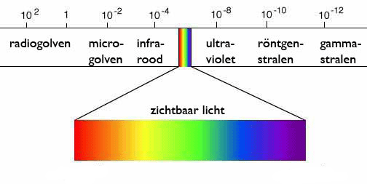
VLC
Voordelen
Lokaal
Minder radio-inferentie
Visual Light Communication
Nadelen
Vrij zichtsveld
Bron: https://ingangsexamen-geneeskunde.be
Smart LED | VLC | Lichtmeting | LED to LED | Idee | Kleuren | Protocol | Samenvatting
Inleiding | VLC | Lichtmeting | LED to LED | Idee | Kleuren | Protocol | Samenvatting

Slide 11
Lichtmeting

Slide 12
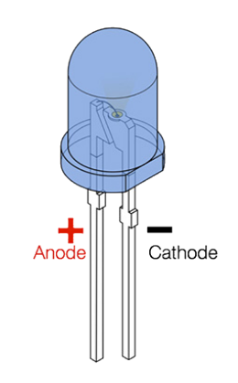
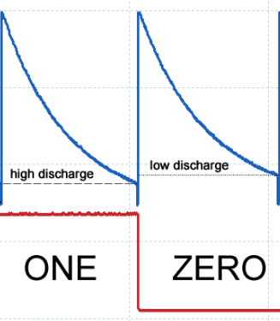
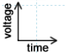
Anode Voltage
Reverse Bias
Bron: "FLICRR: Friendly LED Integrated & Compact Radio Replacement", M. Vandecauter, B. Veys
Bron: "An LED-to-LED Visible Light Communication
System with Software-Based Synchronization", S. Schmid, G. Corbellini, S. Mangold, T.R. Gross
Smart LED | VLC | Lichtmeting | LED to LED | Idee | Kleuren | Protocol | Samenvatting
Inleiding | VLC | Lichtmeting | LED to LED | Idee | Kleuren | Protocol | Samenvatting

Slide 13
LED to LED

Slide 14
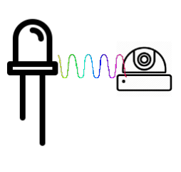
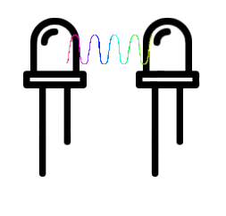
LED naar Camera
Grote Afstand - Eén richting
LED naar LED
Twee richtingen - Kleine afstand
Smart LED | VLC | Lichtmeting | LED to LED | Idee | Kleuren | Protocol | Samenvatting
Inleiding | VLC | Lichtmeting | LED to LED | Idee | Kleuren | Protocol | Samenvatting

Slide 15
Interactive Display

Slide 16
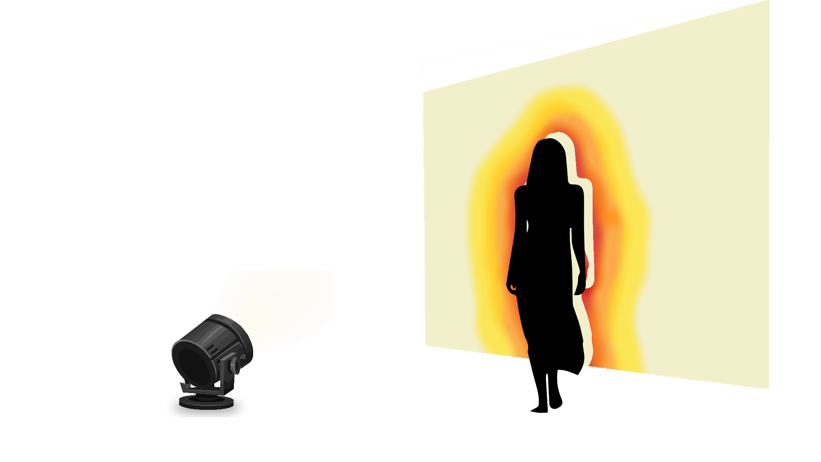
Interactive Display
Smart LED | VLC | Lichtmeting | LED to LED | Idee | Kleuren | Protocol | Samenvatting
Inleiding | VLC | Lichtmeting | LED to LED | Idee | Kleuren | Protocol | Samenvatting

Slide 17
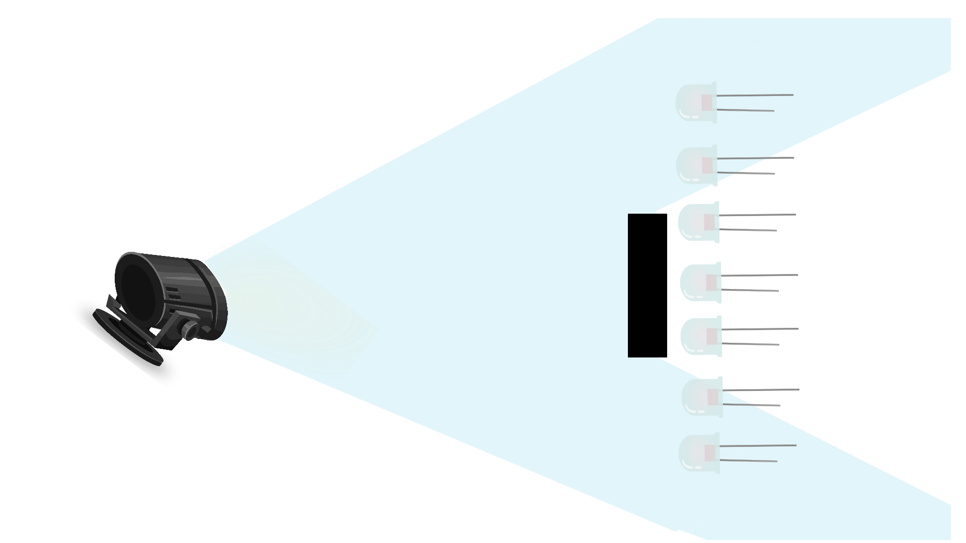
Smart LED | VLC | Lichtmeting | LED to LED | Idee | Kleuren | Protocol | Samenvatting
Inleiding | VLC | Lichtmeting | LED to LED | Idee | Kleuren | Protocol | Samenvatting

Slide 18
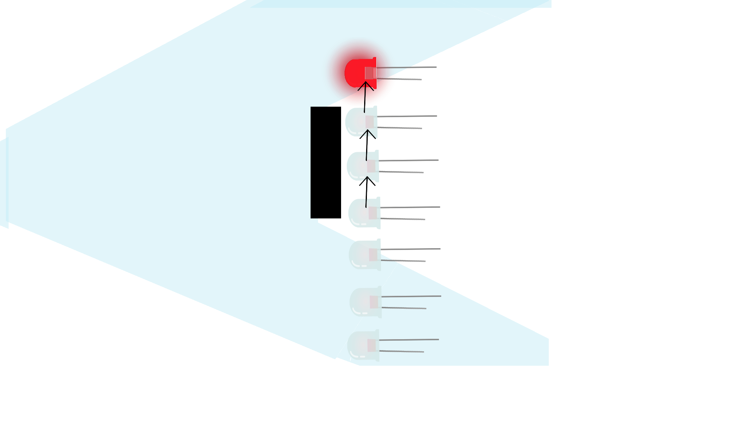
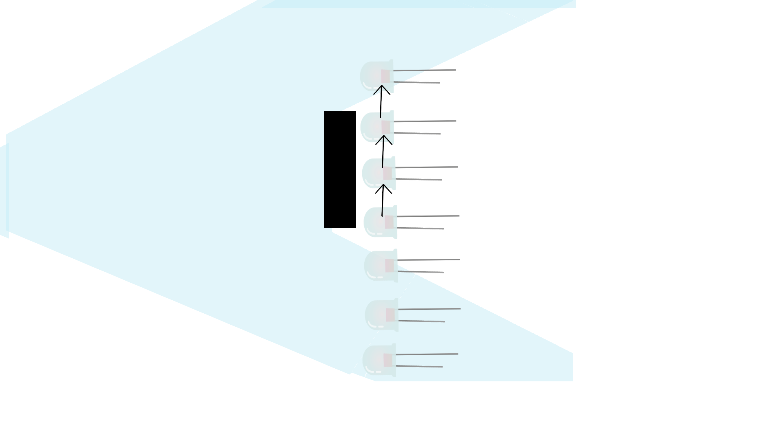
Smart LED | VLC | Lichtmeting | LED to LED | Idee | Kleuren | Protocol | Samenvatting
Inleiding | VLC | Lichtmeting | LED to LED | Idee | Kleuren | Protocol | Samenvatting

Slide 19
Kleuren

Slide 20
Wavelengt Division Multiplexing
Zender
Ontvanger
Inleiding | VLC | Lichtmeting | LED to LED | Idee | Kleuren | Protocol | Samenvatting
Notes:
Voeg animaties toe:
Zenders om de beurt in beeld, met elke zender elke mogelijke ontvanger

Slide 21
Wavelenght Division Multiplexing
 | Detector
E m i t t e r |  | Wit | Rood | Groen | Blauw
 | Wit | 11 | 430 | 405 | 30
 | Rood | 0 | 750 | 0 | 0
 | Groen | 0 | 450 | 105 | 0
 | Blauw | 54 | 30 | 1250 | 270

Slide 22
Protocol

Slide 23

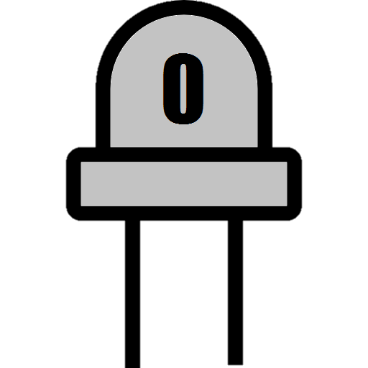


Protocol
On-Of Keying
Manchester encoding
0 =
1 =
0 0 1 0 1
Smart LED | VLC | Lichtmeting | LED to LED | Idee | Kleuren | Protocol | Samenvatting

Slide 24
Protocol
On-Of Keying
Manchester encoding
0 =
1 =
0 0 1 0 1
Smart LED | VLC | Lichtmeting | LED to LED | Idee | Kleuren | Protocol | Samenvatting

Slide 25
Synchronisatie
Zender =>
Ontvanger =>
Zender =>
Ontvanger =>
Inleiding | VLC | Lichtmeting | LED to LED | Idee | Kleuren | Protocol | Samenvatting

Slide 26
Synchronisatie
Synchronisatie patroon
Over-sampling
1 1 | 0 0 | 1 1 | 0 0 | 1 1 | 0 0 | 1 1 | 0 0
1 | 0 | 1
1 1 1
0 0 1
1 1
Inleiding | VLC | Lichtmeting | LED to LED | Idee | Kleuren | Protocol | Samenvatting

Slide 27
Overzicht

